Slide 1
Projekt Praktikum Python
Gruppe 3:
Quoc-Nam Dessoulles
Louis-Adrien Dufrene
Claire Loffler
Hugo Robellaz
Hang Yuan

Slide 2


INTRODUCTION
From the raw data of BeagleBone to their graph display:
Transmission
BBB.py
client.py
server.py
application.py
CLIENT
SERVER

Slide 3
BeagleBoard Skript

Slide 4

IN THE BEAGLEBONE
The main objectives:
1) Get the data returned by the sensors (T°C, P, Humidity, Luminosity)
2) Send them to the Server Side
1) How to retrieve the raw data from the BB?
Go through the good files in the BB and return the values periodically
YES
We save it in a dictionary, where
Key = Type of data
Value = (date, value)
addData(data)
Has the data changed ?
NO
Ex: read_lux() or read_pressure()
RESULT:
The attribute v.data is updated

Slide 5
IN THE BEAGLEBONE
2) How to send the retrieved data to the Server side?
We periodically check if the v.data is
empty?
Call the function sendData of the Client
NO
Clear v.data
YES
No new data to send
Note: The frequency of the functions getdata and sendData calls can be chosen by the user that launches the BB main()

Slide 6
Client-Server Part

Slide 7
CLIENT SIDE
Twisted library manages client/server communication
2 classes: MyClientFactory and Client
How the Client sends the received data to the Server?
New Dictionary: dict
Ex: {‘TEMPERATURE’: [(d1,v1)], ‘PRESSURE’: [(d1,v’1),(d3,v3)]…}
String
Ex:TEMPERATURE|(d1,v1)|(d2,v2)/PRESSURE|(d1,v’1)|(d3,v3)/HUMIDITY…
Convert the incoming dictionary into a string format
sendData(dict)
CLIENT

Slide 8
SERVER SIDE
2 classes: ServerFactory and Server
2 main goals:
1) From the received string construct again the initial dictionary
2) Save it in the .csv file
lineReceived
String
Ex:TEMPERATURE|(d1,v1)|(d2,v2)/PRESSURE|(d1,v’1)|
(d3,v3)/HUMIDITY…
Reconvert into the dict
format
saveDataCSV
addData
SERVER

Slide 9
Verarbeitung

Slide 10
SAVING OF DATA
addData
saveDataCSV
saveDate
loadData

Slide 11

User Interface

Slide 12

Pyramid
Template designed in HTML (Chameleon)
Serve Static Files (CSS, JS…)
Serve dynamically plot image files (FileResponse)
Easy use of GET & POST Requests

Slide 13
Structure
Application.py
:Inherit
Layouts
ProjectorViews
globals.py
Graph(data)
Graph
getData( )
Data( )
Data
cacheData( )
dataSaved.csv

Slide 14
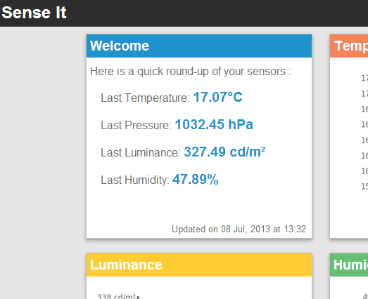
Demo

Slide 15

CONCLUSION
Two main problems we faced during the course of the project:
1) Internal communication
Boundary of everyone’s work
2) Initialization of Beagle Bone
Installation of modules (like Twisted)

Slide 16


Thank you for your attention!

